Slide 1
DSC530 Final Project
David Suffolk

Slide 2
Statistical Question/Hypothesis
If a customer pays for an app on their phone (compared to getting it for free), is that a signal of higher satisfaction with the product?
The marketplace for apps is filled with free applications and many have the option to purchase a premium version while some are only available if purchased.
If a customer is happy enough with the free app that they are willing to upgrade to a paid version, shouldn’t paid apps have higher ratings in the app store?
Since there are free options available and a customer chooses to purchase a different app instead, does this reflect higher satisfaction in the app through ratings and reviews?

Slide 3
Overview of Variables
The dataset contains information on apps within the Google Play Store
The five variables that will be the focus of the project are the following:
Rating - The overall rating the app has received based on user reviews
Reviews - The number of reviews the app has received
Installs - The number of installs the app has received
Type - Binary variable defining if the app is Free or Paid
Content Rating - The recommended maturity level for the user accessing the app
Rating, Reviews, and Installs all speak to the engagement between user and app and can give an overview of how a particular app is viewed by users.
Content Rating is one method of determining what types of apps are installed, rated, and reviewed.

Slide 4
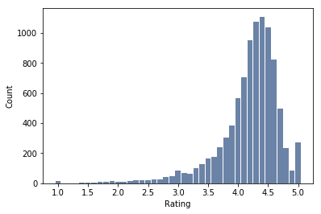
Rating
Histogram shows a left-skewed distribution
Mean: 4.192
Mode: 4.4
Median: 4.3
Variance: 0.265
Standard Deviation: 0.515

Slide 5
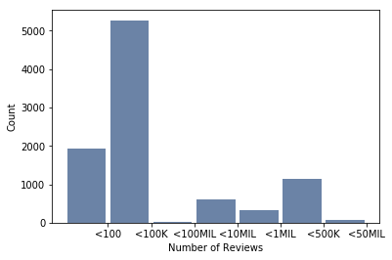
Reviews
Histogram shows that most apps receive less than 100K reviews
Mean: 514,049
Mode: 2
Median: 5,930.5
Variance: 9,885,000,896,407.732
Standard Deviation: 3,144,042.127

Slide 6
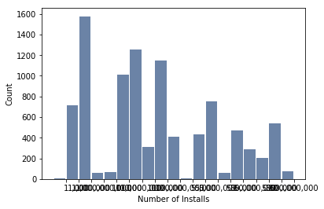
Installs
The histogram shows that most apps have less than 1 million installs
Mean: 17,897,443.726
Mode: 1,000,000
Median: 500,000
Variance: 8,324,412,310,163,610
Standard Deviation: 91,238,217.377

Slide 7
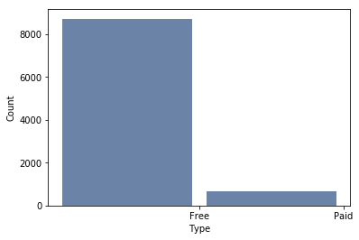
Type
Histogram shows that most of the apps in the data are Free
For calculations, the values were made binary. Free = 0. Paid = 1.
Mean: 0.069
Mode: 0
Median: 0
Variance: 0.064
Standard Deviation: 0.254

Slide 8
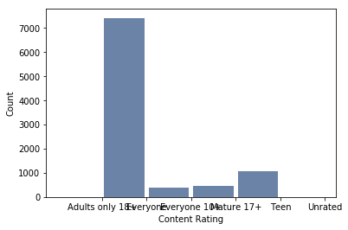
Content Rating
The histogram shows that most of the apps have a Content Rating of Everyone
For calculations, the following numeric values were assigned:
Unrated - 0
Everyone - 1
Everyone 10+ - 2
Teen - 3
Mature 17+ - 4
Adults only 18+ - 5

Slide 9
Content Rating
Unrated - 0, Everyone - 1, Everyone 10+ - 2, Teen - 3, Mature 17+ - 4, Adults only 18+ - 5
Mean: 1.423
Mode: 1 (Everyone)
Median: 1 (Everyone)
Variance: 0.775
Standard Deviation: 0.88

Slide 10
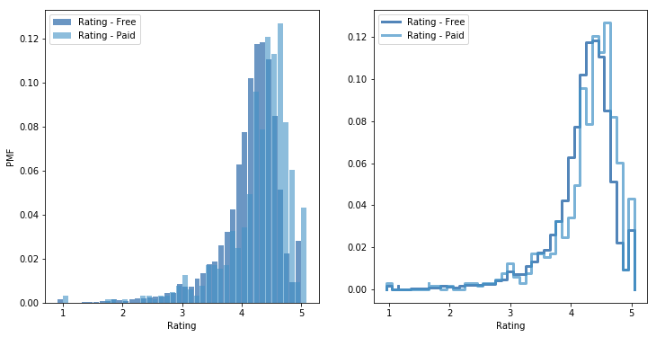
PMF

Slide 11
PMF
For PMF, I looked into the ratings of Free apps against the ratings of Paid apps
Based on the graphs on the previous slide, Paid apps do seem to receive a higher frequency of higher ratings.

Slide 12
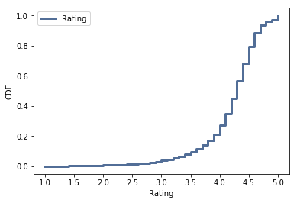
CDF
The CDF for Ratings shows that a very low percentage of apps get a rating lower than 4. In fact, only about 20% of the apps have a rating that is below 4 out of 5.

Slide 13
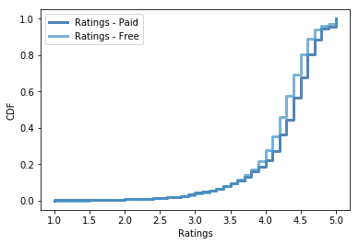
CDF Comparison
When comparing the CDF of ratings for Paid and Free apps, we see that the line for Paid apps is slightly to the right of Free apps.
We can see that there is a slightly higher chance of Paid apps receiving a higher rating than Free apps.

Slide 14
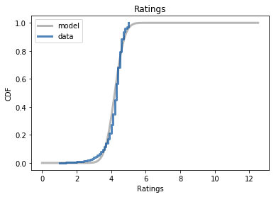
Analytical Distribution
Compare the CDF of Ratings to a normal model with the same variance and mean
Mean: 4.208
Variance: 0.202
The data for the CDF of Ratings fits the model very closely indicating a normal distribution for a model with the same variance and mean.

Slide 15
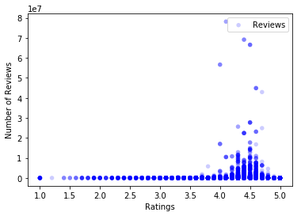
Scatter Plot #1
The Scatter Plot shows the Rating against the Number of Reviews
We can see that most reviews give a rating between 4 and 5
Covariance: 110,368.519
Indicates a positive relationship between the two variables
Pearson: 0.068
Close to zero indicating no relationship
Spearman: 0.156
Higher than 0.05 so it is not statistically significant

Slide 16
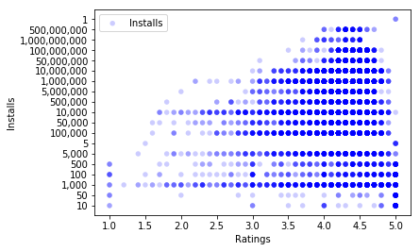
Scatter Plot #2
The Scatter Plot shows Ratings against the number of Installs
We can see that as the installs increase, the variance in Ratings decreases
Covariance: 2,413,799.731
Indicates a positive relationship between the two variables
Pearson: 0.051
Close to zero indicating no relationship
Spearman: 0.0695
Slightly higher than 0.05 so we should consider it statistically insignificant

Slide 17
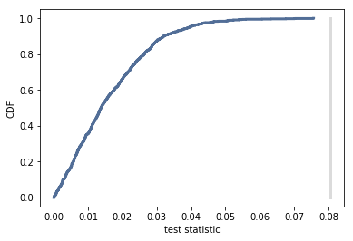
Hypothesis Test
I used Difference of Means with the Null Hypothesis that there is no difference between the ratings for Paid apps vs. Free apps.
The result was 0 which indicates that the null hypothesis should be accepted indicating that there is no significant difference between the ratings for Paid and Free apps.

Slide 18
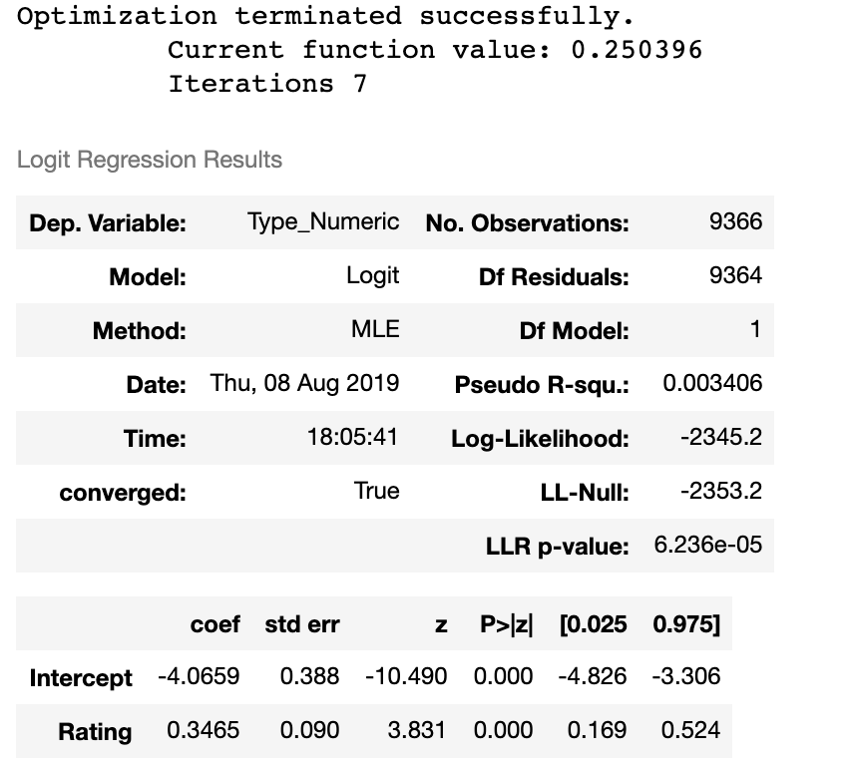
Regression Analysis
Compared Rating as a predictor of Type (Free vs. Paid)
The Coefficient is 0.3465 which means that there is a moderate positive relationship between the rating of a paid app.

Slide 19
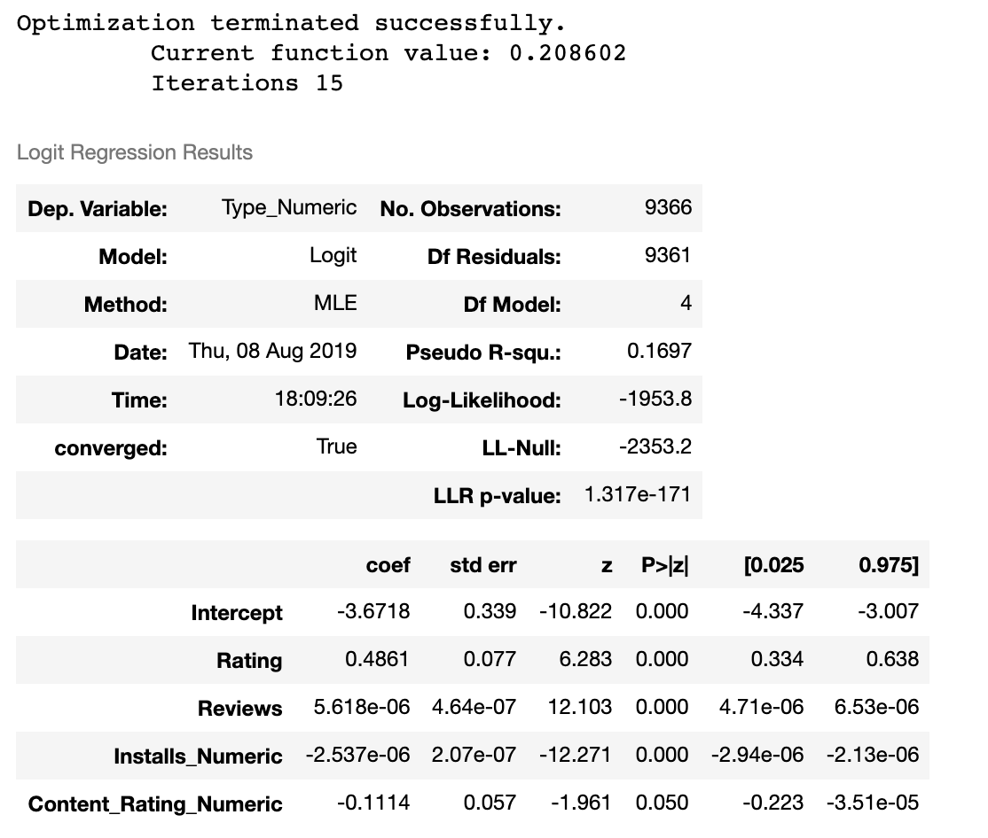
Regression Analysis
Compared all variables as a predictor of Type (Free vs. Paid)
The Coefficient for Rating increases when controlled for Reviews, Installs, and Content Rating. The value is 0.4861.
However, this relationship is still a moderately positive.

